Slide 1







Autism Awareness

Slide 2


At least one in one hundred people in the UK have autism. There are around 700,000 people in the UK living with autism.
I have autism.

Slide 3
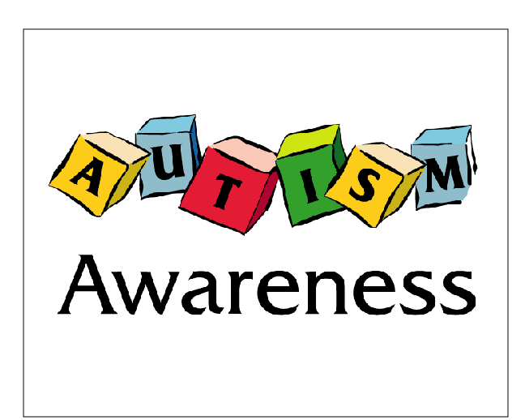
Autism Awareness Week aims to give people a greater understanding of autism.
Notes:
https://www.flickr.com/photos/genomegov/27025657576/sizes/l

Slide 4
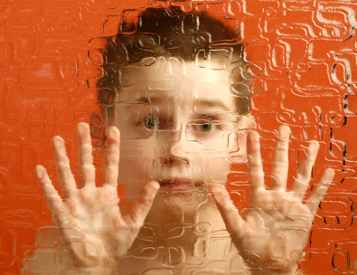
Imagine being in a foreign country; not being able to speak or interpret the language and not able to make yourself understood.
Notes:
https://www.flickr.com/photos/57570482@N06/5299266366/sizes/o/

Slide 5
Imagine not knowing what was going to happen to you next.
Notes:
https://www.flickr.com/photos/57570482@N06/5299266366/sizes/o/

Slide 6
That is a little bit what it is like to have autism.
Notes:
https://www.flickr.com/photos/57570482@N06/5299266366/sizes/o/

Slide 7
People with autism often have difficulty recognising or understanding others' feelings and intentions and expressing their own emotions. This can make it very hard for them in social situations.

Slide 8

People with autism may not be comfortable with eye contact.

Slide 9

People with autism may experience over or under sensitivity to sounds and noises. They may find certain background sounds, which other people can ignore or block out, unbearably loud or distracting.

Slide 10

Many people with autism have amazing talents associated with high levels of creativity and thinking outside of the box.

Slide 11
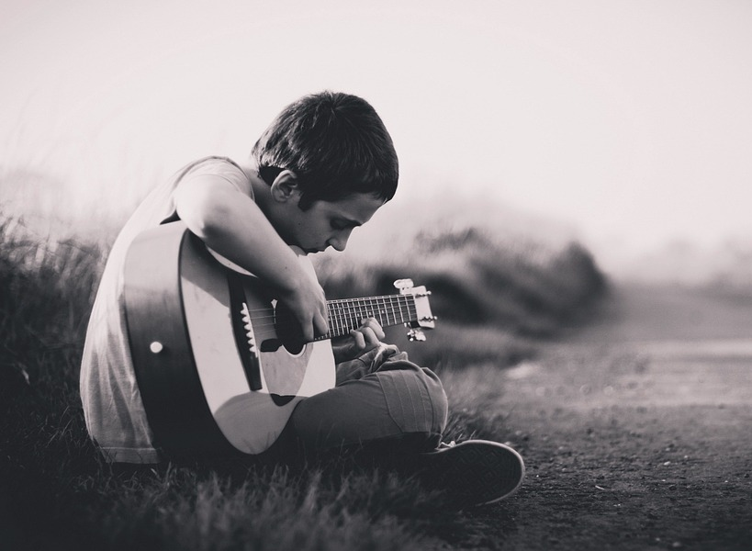
Some people with autism have a talent for music. They can just pick up an instrument and play something they have heard.

Slide 12

Stephen Wiltshire has the ability to draw from memory a landscape after seeing it just once.
Notes:
https://www.google.co.uk/search?q=Stephen+Wiltshire&espv=2&stick=H4sIAAAAAAAAAONgVeLUz9U3MDbOLSo2EkosKsksLlEozyzJUEgsBbJzTzEi5KFsw5IU4yIo26iwstgUyrY0zTIpOcXIBWKXZGdnG5XBNFumVGU_YlzKyC3w8sc9YanZjJPWnLzGOIWRS8AnP784NacyKDUnsSQ1JSRfSImLzTWvJLOkUkiCi1uKHaQ9vTxLg0GKkwvGEYrh4g5OLQnJ981PyUyrFPIV8ubi9E3NTUotKvZPE7Lj4nLOz8lJTS7JzM8TMuASlxLWT4YL6EO8WAw0UZQLmwQPAFGLsFcTAQAA&source=lnms&tbm=isch&sa=X&ved=0ahUKEwiG_dDkjuzSAhULDsAKHYHgAjUQ_AUIBigB&biw=1600&bih=794&dpr=1#q=Stephen+Wiltshire&stick=H4sIAAAAAAAAAONgVeLUz9U3MDbOLSo2EkosKsksLlEozyzJUEgsBbJzTzEi5KFsw5IU4yIo26iwstgUyrY0zTIpOcXIBWKXZGdnG5XBNFumVGU_YlzKyC3w8sc9YanZjJPWnLzGOIWRS8AnP784NacyKDUnsSQ1JSRfSImLzTWvJLOkUkiCi1uKHaQ9vTxLg0GKkwvGEYrh4g5OLQnJ981PyUyrFPIV8ubi9E3NTUotKvZPE7Lj4nLOz8lJTS7JzM8TMuASlxLWT4YL6EO8WAw0UZQLmwQPAFGLsFcTAQAA&tbm=isch&tbs=sur:fc&*&imgrc=hUxcmZidEURRDM:

Slide 13
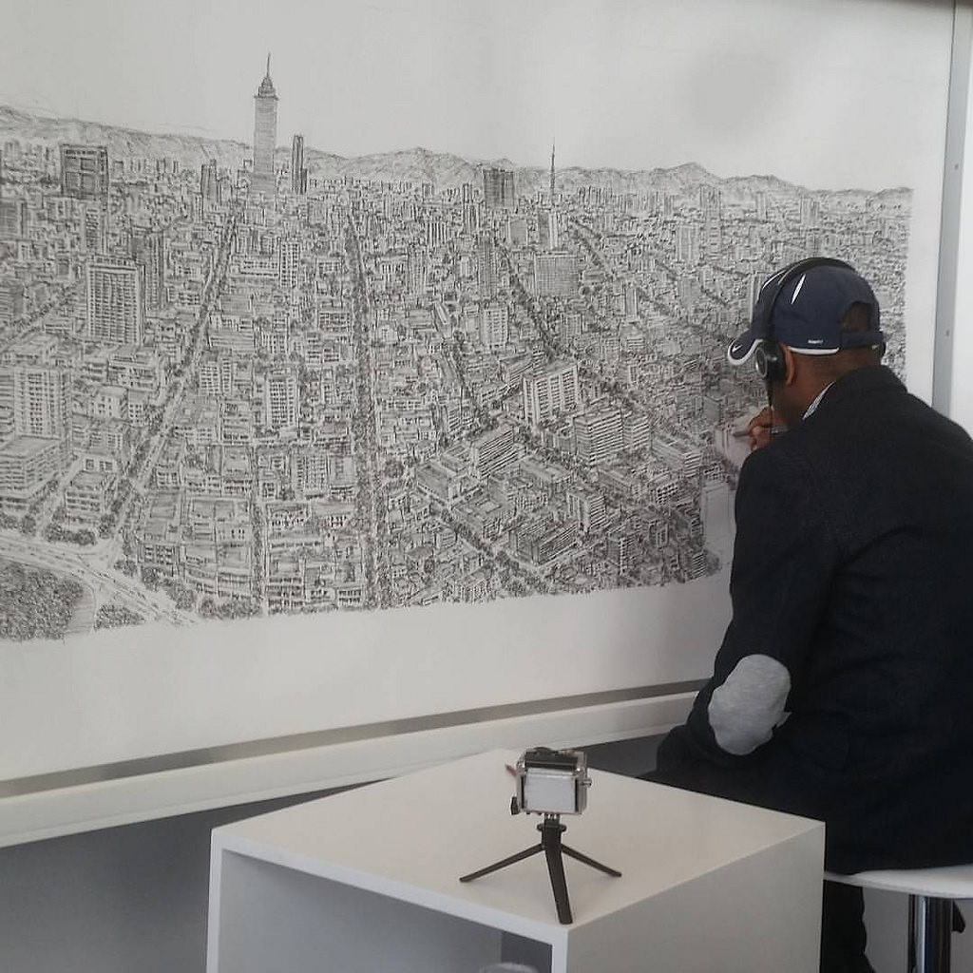
At the age of 11 he produced a detailed drawing of four square miles of London after a single helicopter ride above the city.
Notes:
https://www.flickr.com/photos/vladimix/30506892852/sizes/l

Slide 14
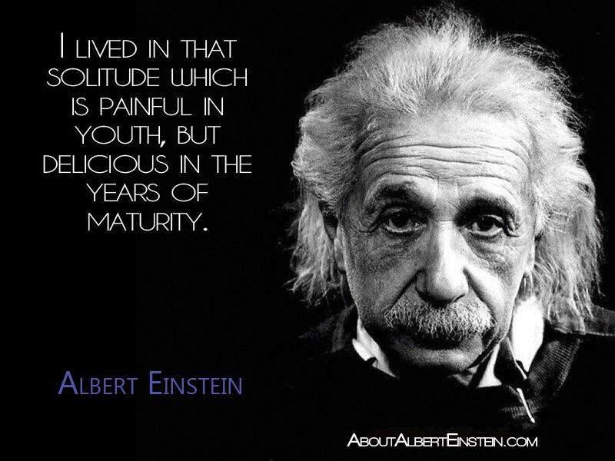
According to researchers, Einstein showed signs of autism from an early age. As a child, he was a dreamer and a loner, repeated sentences obsessively until he was seven, could not make friends and lacked social skills. He disliked socks and chose not to wear them.
Notes:
By Rnunezart - Own work, CC BY-SA 4.0, https://commons.wikimedia.org/w/index.php?curid=42835445

Slide 15



