Slide 1

Meet the teacher
Acorn Class

Slide 2
Acorn Class Team
•Mrs Harrison – Class Teacher 4 days
•Miss Clark – LSA

Slide 3
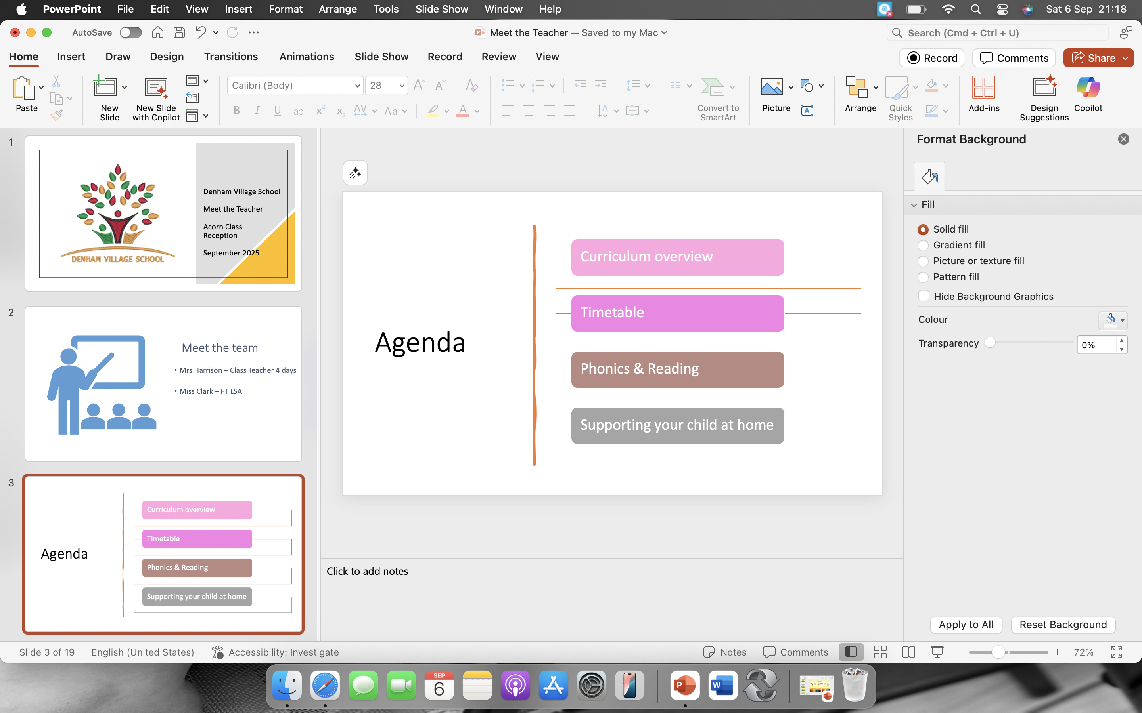
Agenda

Slide 4
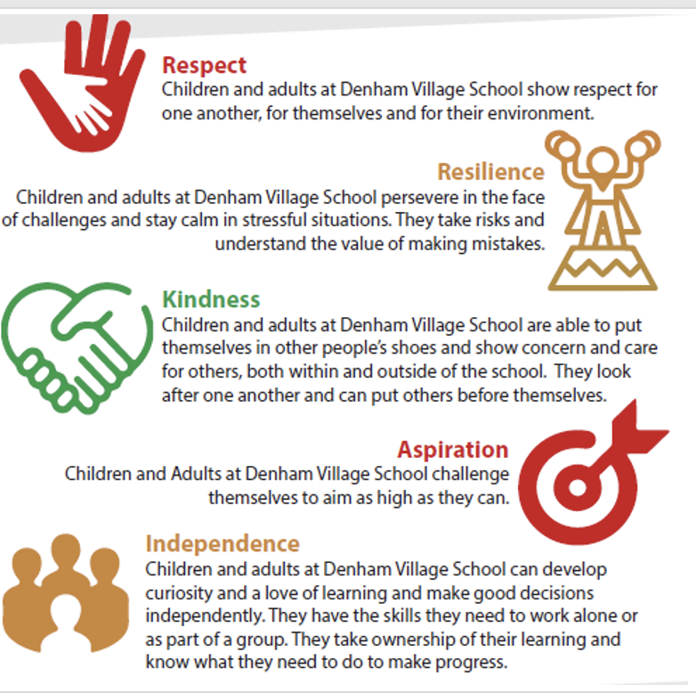
Values

Slide 5
School Rules
We are kind and respectful
We are gentle
We are honest
We listen to people
We work hard
We look after property

Slide 6
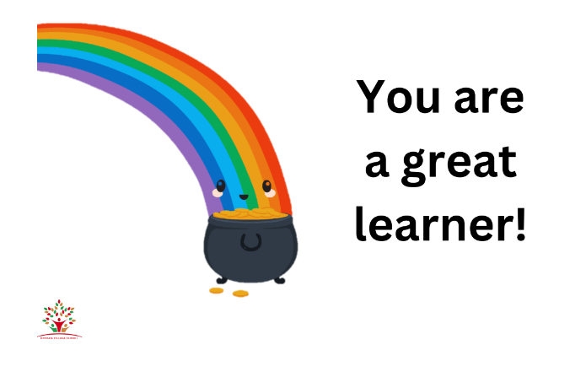


Behaviour

Slide 7
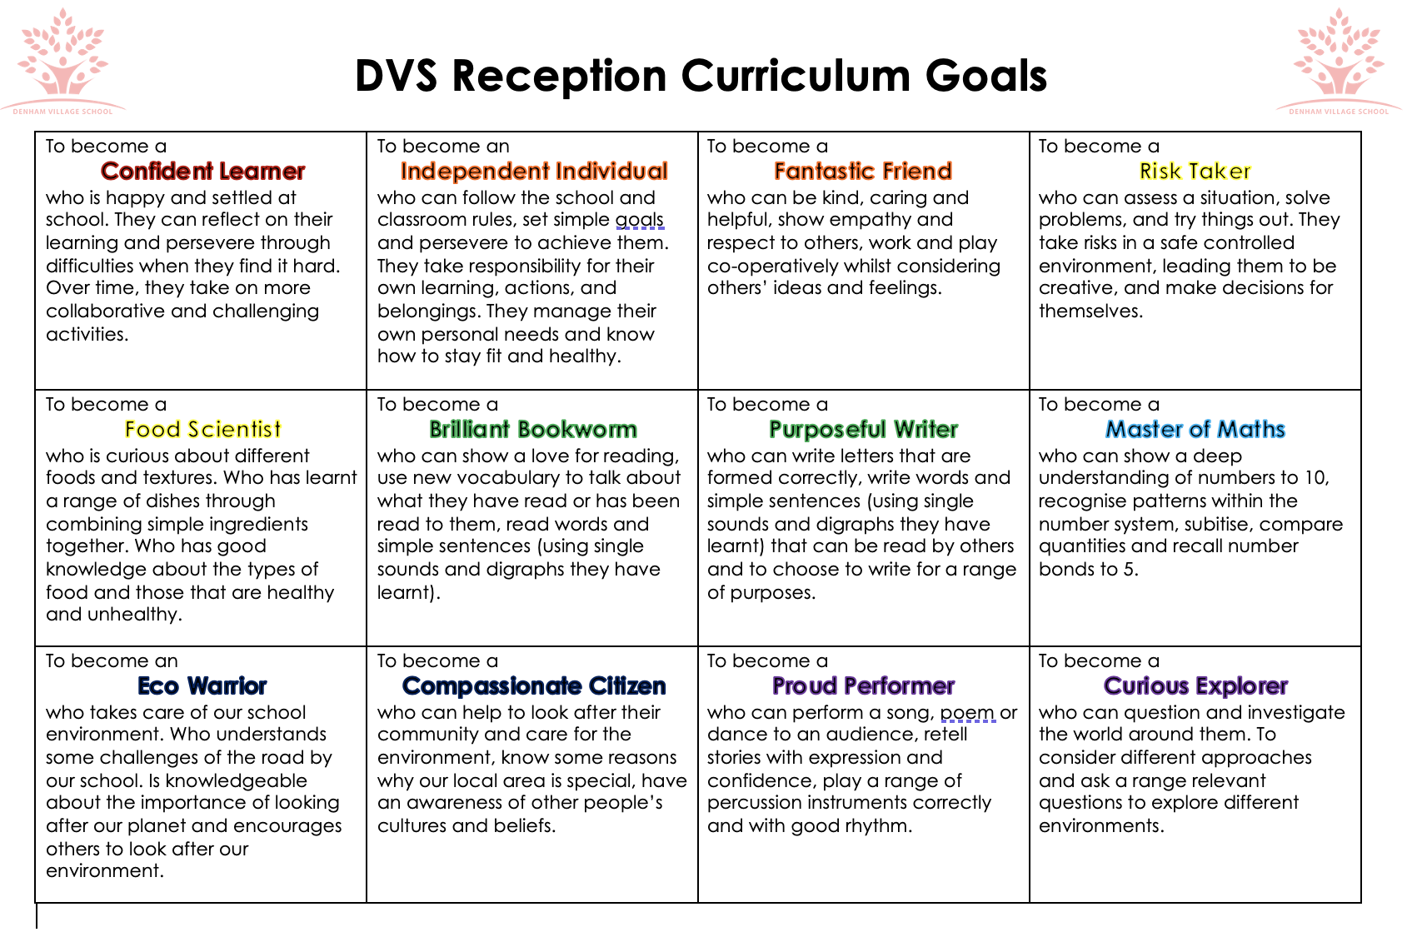
Notes:
Prime areas of development and learning lay vital foundations in the early years. The three prime areas are: Communication and Language, Personal, Social, Emotional Development and Physical Development. The four specific areas are: Literacy, Mathematics, Understanding the World, Expressive Arts and Design which build on the development gained through the prime areas.
The aim is to follow the children’s interests and fascinations and the children are encouraged to be independent in their choice of activity and learning.
There is a strong emphasis on outdoor learning.

Slide 8
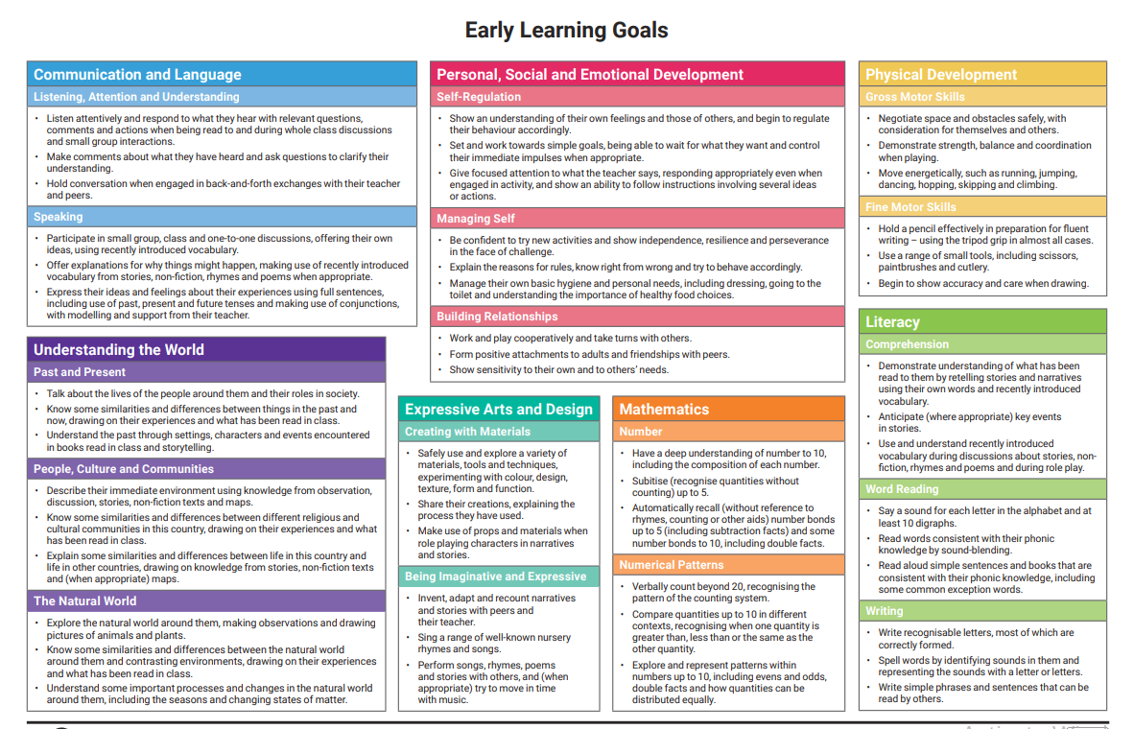

Slide 9
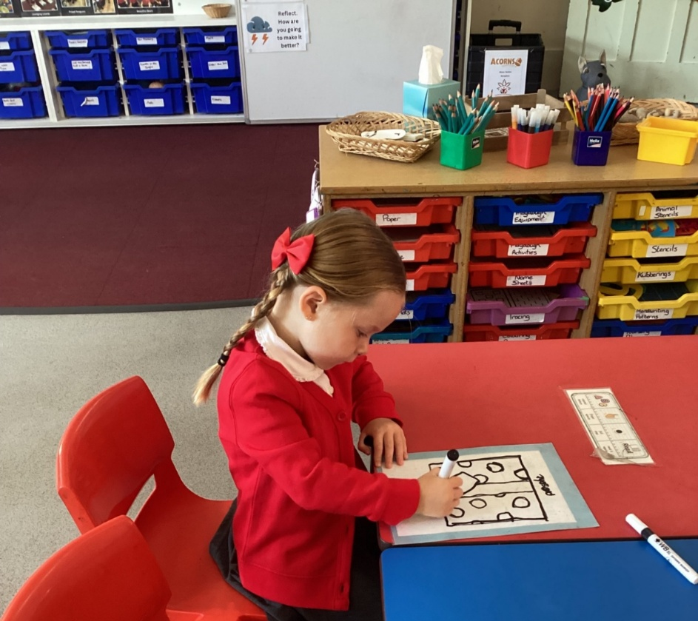
Assessment
Ongoing observations of your child’s learning and progress, linked to Early Years Development Matters Framework.
Assessed during independent and focus teaching time – although it may look like they are just playing, each activity has a planned learning objective, providing the opportunity for your child to apply skills previously taught.
You can help us!

Slide 10
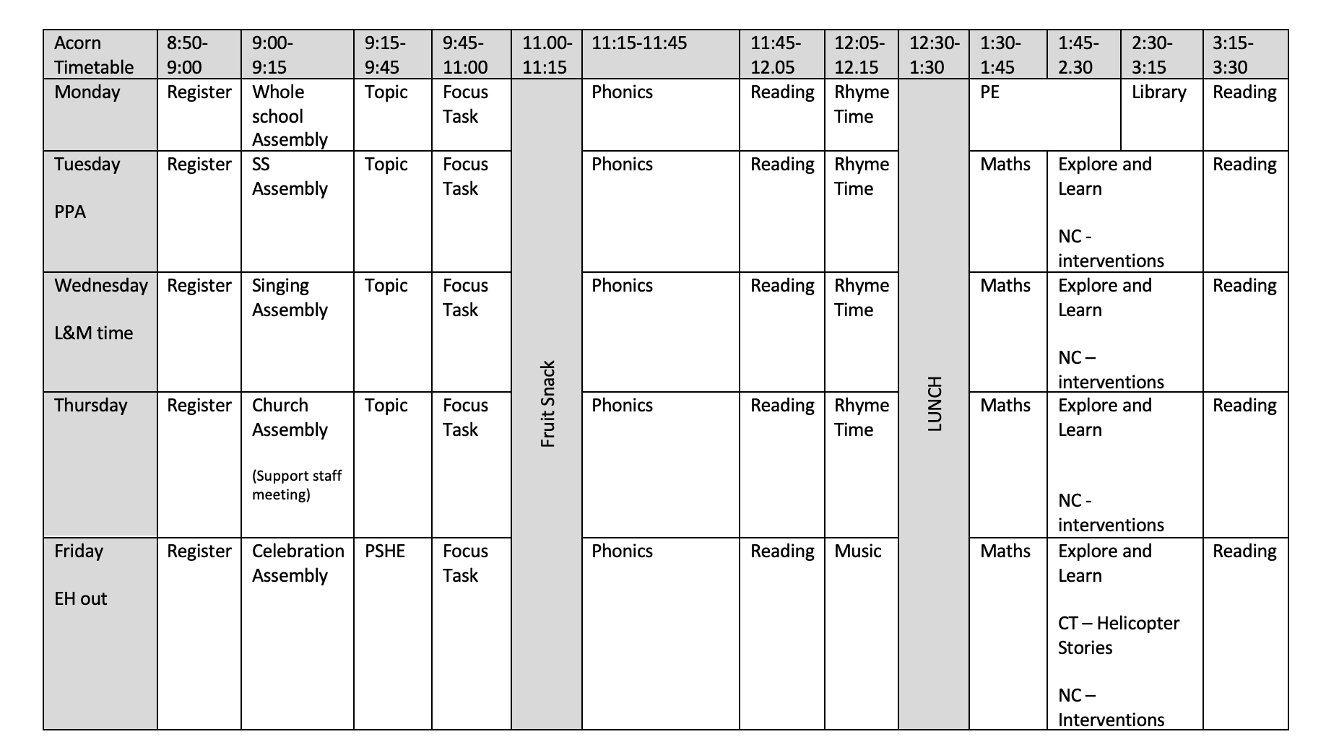

Slide 11
Half term
The first half term your child starts full time school is all about allowing them the opportunity to settle in, make friends and for us to get to know them through play.
Some children take longer than others to settle in, so please do not worry if your child takes a while to settle, we will get there by working together.
During this time observations and assessments will be carried out with your child. There will then be a parents evening at the end of the first half term which will involve talking through what stage your child is at and how we will continue to observe and assess them through reception.

Slide 12
Phonics
Little Wandle
Daily teaching and same day catch up
Phonics teaching begins with a focus on initial sounds.
It builds up to blending these sounds to make words.
Common exception words are taught alongside this.
Assessed at the end of each half term.

Slide 13
Reading
Your child will read 3 times a week with an adult and books will be changed once a week.
The reading book and a book bag book will be sent home on a Thursday.
Please return the books on Thursday. We will not issue a new book until the previous ones are returned.
The school books are arranged in phases, enabling your child to practise the sounds they have been learning in their Phonics teaching.
Children should be reading the books at 90% fluency.
We will also begin visiting the school library.

Slide 14
Expectation of reading every night and this needs to be recorded in their planners.
Model positive reading behaviour
Establish a routine so that reading takes place where it is quiet and without distraction
Make reading an enjoyable experience
What if my child struggles with a book?
Allow time for your child to self-correct
Use positive language when correcting mistakes
Re-read pages to develop fluency, expression and comprehension
My child finds their book easy. What should I do to challenge them?
Discuss the pictures, characters and plot
Retell story in own words and suggest alternate endings
Focus on asking questions to allow the children to think beyond the story, share different genres and the purpose for reading them, encourage the learning of HFW and CEW.
Remember children should be reading the book at 90% fluency
Reading at home

Slide 15
Provide opportunities for your child to experience a wide variety of reading materials.
Read regularly to your child, modelling the skills and behaviours of a good reader.
Incorporate learning into everyday experiences.
Complete the home learning tasks on the weekly newsletter.
General independence: putting on own coat, making own decisions, responsibility for own belongings.
Helping at
home

Slide 16
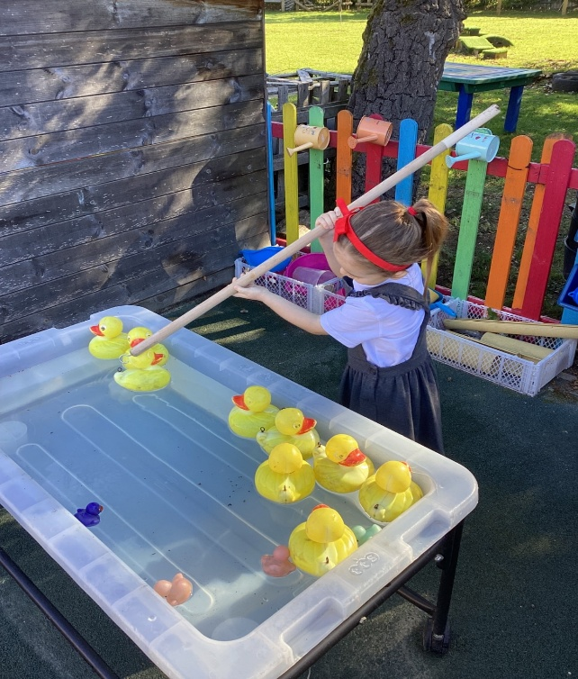
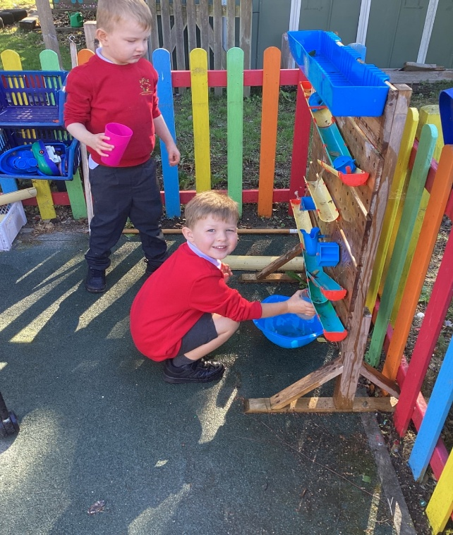
Tapestry
In 2021/22 the EY reforms advised schools to step away from online platforms.
We will no longer be using tapestry however information and newsletters will be on the Acorn page on the school website.
You will also find the half termly class information sheets there.
WOW moments

Slide 17
This Year
Harvest Celebration
Stay and Play
Pantomime
Nativity
Forest School
Summer Term Trip
Notes:
There is lots of other events throughout the year so please read the weekly newsletters and check the school website for dates.

Slide 18
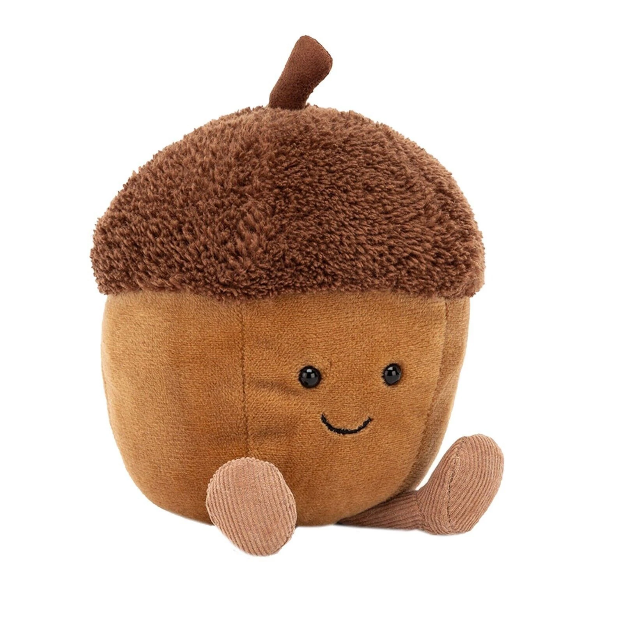
Arthur the Acorn

Slide 19

Publishing Book

Slide 20
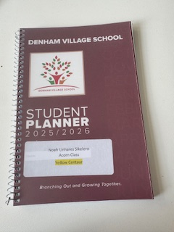
Planners

Slide 21
Helpful Reminders
Please send wellington boots in at the start of the year.
Names in all items of clothing and property
Please do not bring anything to school all resources are provided in the EYFS.
Water bottles/snacks
Please ensure all uniform is correct and is in line with the uniform policy.
PE and library day - Monday

