Slide 1

Oak Class
Meet the teacher
Year 5 and 6
Denham Village School

Slide 2
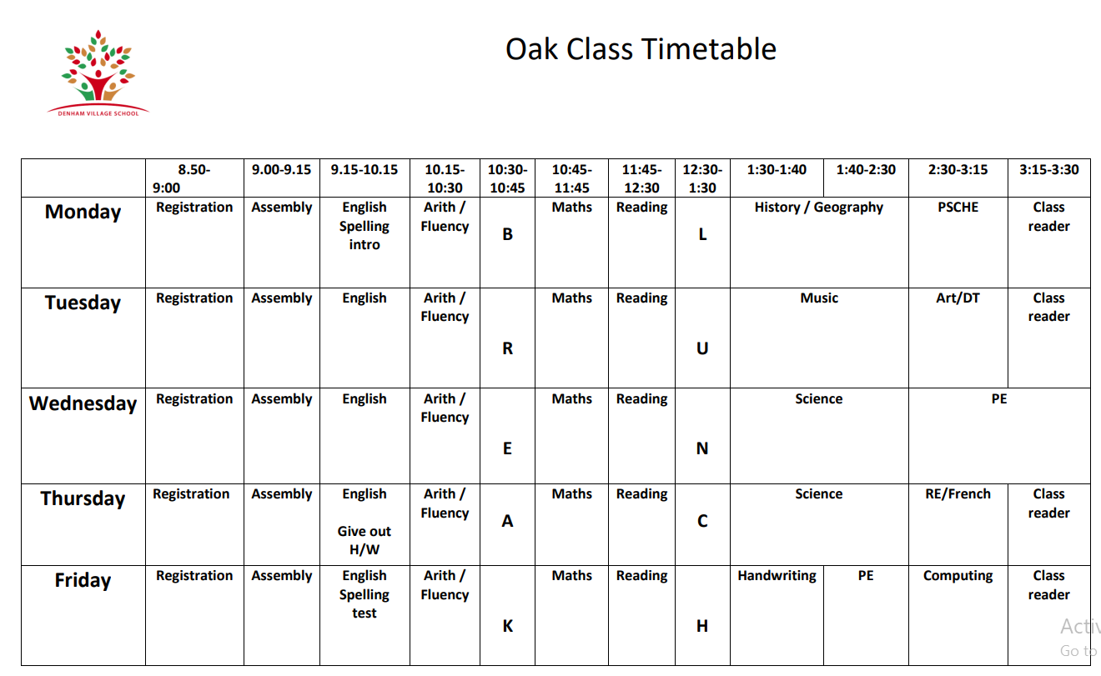

Slide 3
Our Topics
Autumn 1
What was the impact of WW2 on the people of Britain?
Autumn 2
What is life like in the Alps?
Spring 1
How did the Maya Civilisation compare to the Anglo-Saxons?
Spring 2
Would you like to live in the desert?
Summer 1
What does the census tell us about our local area?
Summer 2
Where does our energy come from?

Slide 4
How is Upper Key Stage 2 different?
Notes:
Developing independence, responsibility, role models, academically (higher expectations) consistency

Slide 5
Supporting your child
Reading daily (at least 5 times a week)
Modelling Reading
Discussing what they have been reading
Ask your child to summarise
Vocabulary
Read to your child.

Slide 6
Homework
Spelling list
Sumdog
Homework to include: a maths sheet, reading comprehension, four spelling sentences and a GPS task
Homework is handed out on Thursday to be handed in by Tuesday.
The quality and presentation of homework is expected to be the same as we would expect in school.
Notes:
Additional online activities may be sent during this year.

Slide 7



Behaviour

Slide 8
PE
Wednesday and Friday

Slide 9
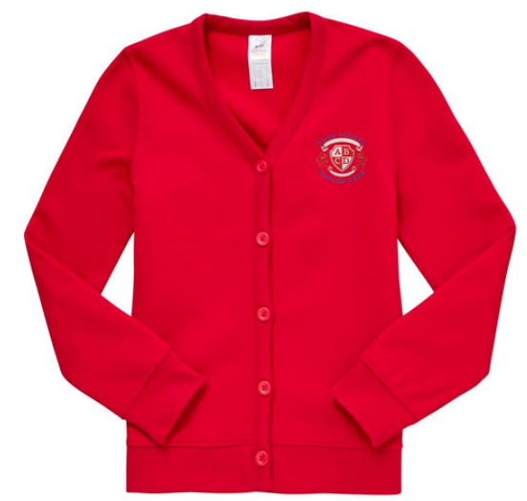
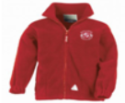


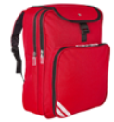
School Uniform
Please check the link on the school website.
PE kits
Notes:
Fleece for PE days only. Not to be worn over jumpers.

Slide 10
What should my child bring to school?
Pens, pencils, colouring pencils, ruler, eraser, pencil case
Reading book and reading record every day
School bags and coats. Please ensure everything is named.
Lunchboxes are stored in hall.
Children can bring in a healthy snack for playtimes e.g. fruit. If using a container for the snack, please ensure your child’s name is written on it.

Slide 11
Water Bottles
Children must also bring a water bottle to school everyday. They are stored near the sink. They can drink water in the classroom at appropriate times and take them outside at playtimes.

Slide 12
Please ensure your child is on the playground ready to enter the classroom at 8:50am. The school day finishes at 3.30pm.
•If your child comes to breakfast club, this starts from 8am onwards.
•If someone other than you is picking up your child please let the office and me know in advance and ensure you have provided that person with your chosen password.
•If you are picking up your child during the school day, e.g for a medical appointment, please ensure that you let the office know and they will pass the message on to me.
Drop offs and pickups

Slide 13
What is happening this term?
WBST
Pantomime
11+
Carol Service at the Church
Notes:
Talk about the importance of attendance

Slide 14
What is happening this year?
Longridge
SATS
Forest School
Notes:
Talk about the importance of attendance

Slide 15
Attendance
Notes:
Talk about the importance of attendance

Slide 16
Communication
Please call the office or speak to me after school.

Slide 17
Responsibilities
House Captains
Various roles in the classroom and around the school.

Slide 18

Deadline: 31st October

Slide 19
Thank you for your time. Any questions?

