Slide 1

5 WAYS TO WELLBEING
‘CONNECT’

Slide 2
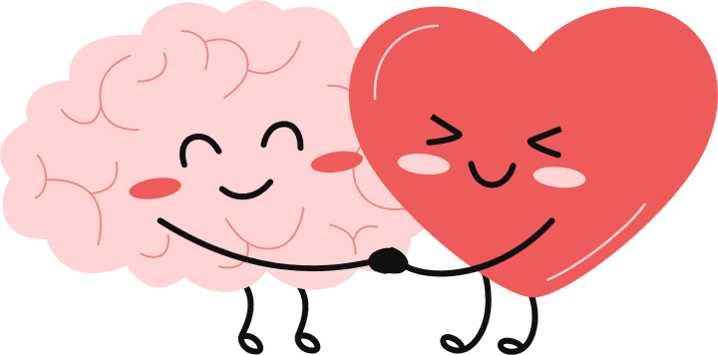
MENTAL HEALTH AND WELLBEING
Wellbeing is...
  How we feel in our minds
  How we feel in our bodies
  How we get along with other people
  How we cope with our day
It’s about feeling safe, happy, healthy, and able to enjoy life, most of the time.
Everyone’s wellbeing goes up and down, and that’s completely normal.
Notes:
introduce wellbeing and why it is important
It helps us learn
It helps us make friends
It helps us solve problems
It helps us feel confident

Slide 3

KEEP LEARNING
BE ACTIVE
5 WAYS TO WELLBEING
TAKE NOTICE
CONNECT
GIVE
Notes:
Explain what mental health is – its about our feelings, thoughts, emotions and moods
Everyone knows how to look after their physical health – examples?
But it can be difficult to know what to do to look after our mental health.

Slide 4
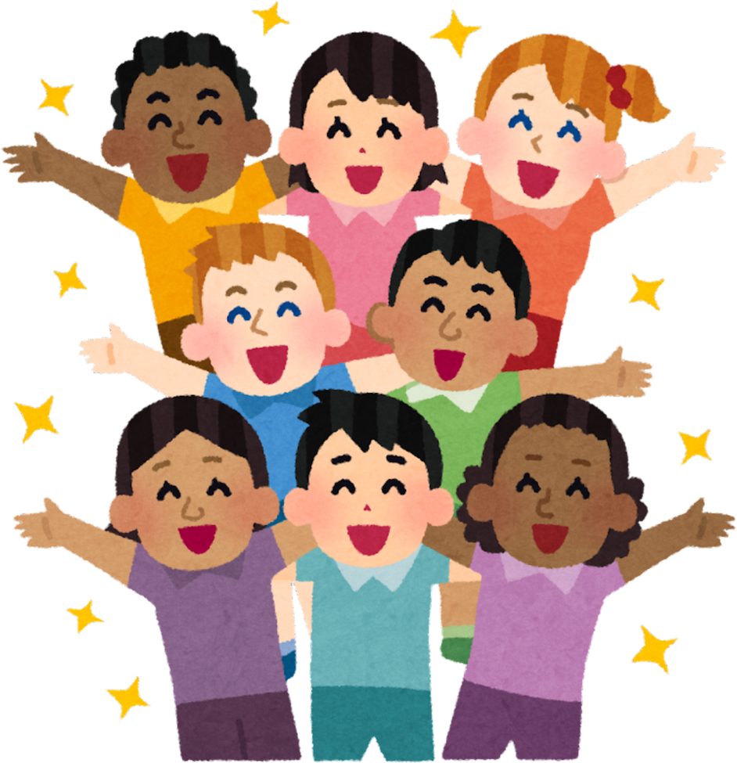
We all need other people. When we connect with others, it helps us feel happier and less alone.
CONNECT
Notes:
“Put your hand up if you have a friend.”
“Put your hand up if someone has ever helped you when you felt sad.”
“Put your hand up if someone smiling at you has made your day better.”

Slide 5
H
HOW?
Connecting means spending time with other people, talking, listening, helping and being kind.
Talking with friends at playtime
Working together in class
Spending time with family
Working together in class
Working together in class
Helping someone who is lonely
Working together in class
Helping someone who is lonely
Notes:
Explain what mental health is – its about our feelings, thoughts, emotions and moods
Everyone knows how to look after their physical health – examples?
But it can be difficult to know what to do to look after our mental health.

Slide 6


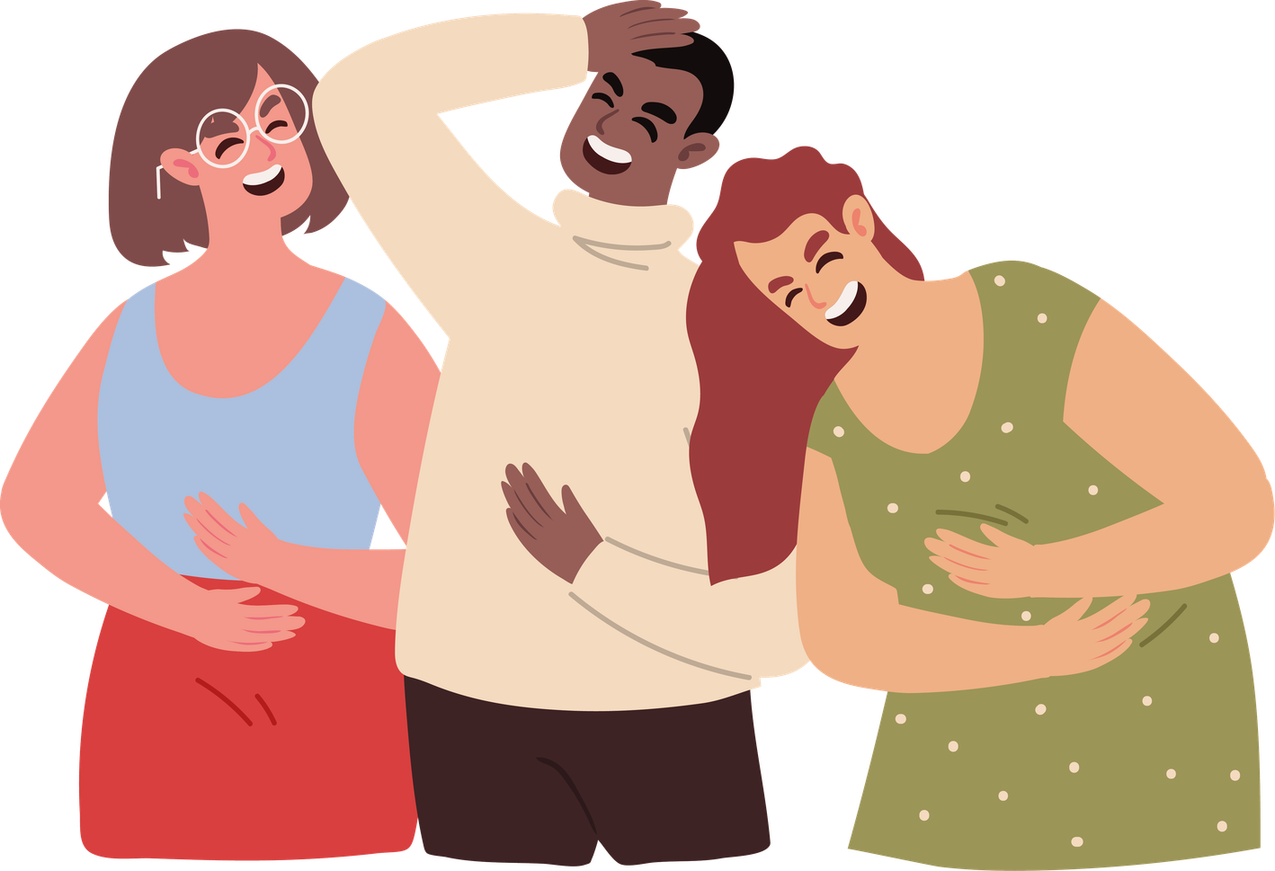

H
Connection helps us feel happy!
When we talk, laugh, and spend time with other people, our brains release chemicals that make us feel good.
Notes:
Think about how you feel when someone invites you to play. Most people feel happier straight away.
Has anyone got a good appropriate joke?
1.
Why did the teddy bear say no to dessert?
Because it was already stuffed!
2.
What do you call a bear with no teeth?
A gummy bear!
3.
Why did the cow go to space?
To see the moooon!
4.
Why did the student eat his homework?
Because the teacher said it was a piece of cake!
5.
Why was the maths book sad?
Because it had too many problems!
6.
Why did the pencil get an award?
Because it was very sharp!
7.
What do you call cheese that isn’t yours?
Nacho cheese!
8.
Why can’t you give Elsa a balloon?
Because she will let it go!
Turn to the person next to you and smile..

Slide 7
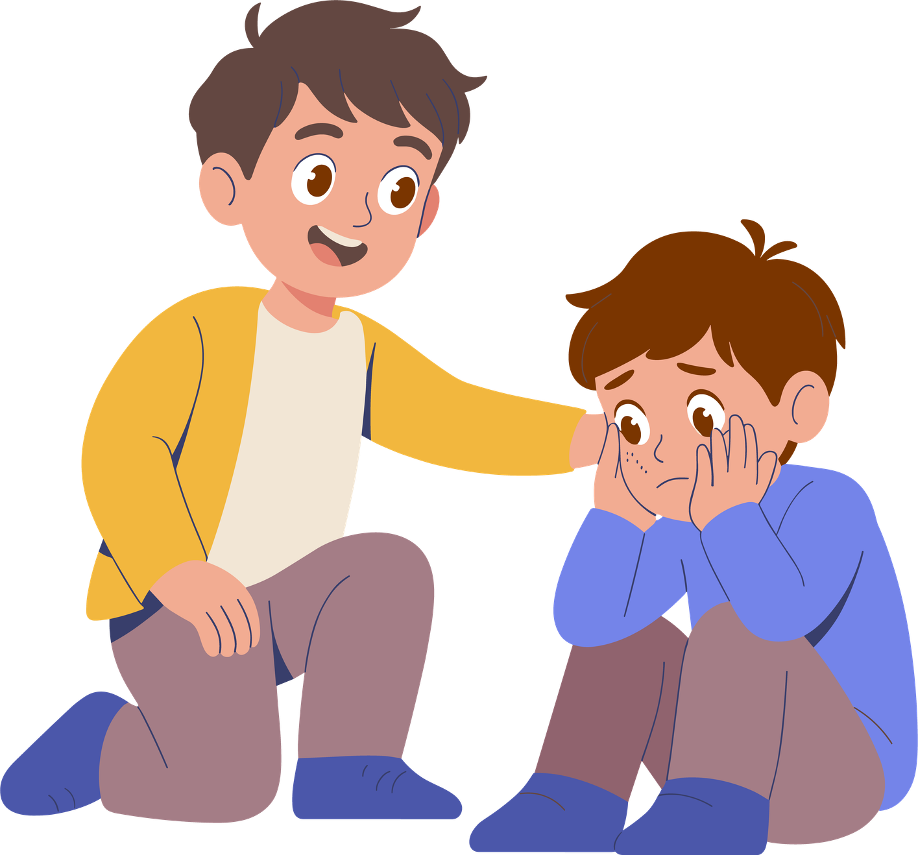

H
Connection helps us when things are hard!
Problems often feel smaller when we share them with someone.
What might this look like?
Notes:
How can someone help you with big or difficult emotions?

Slide 8
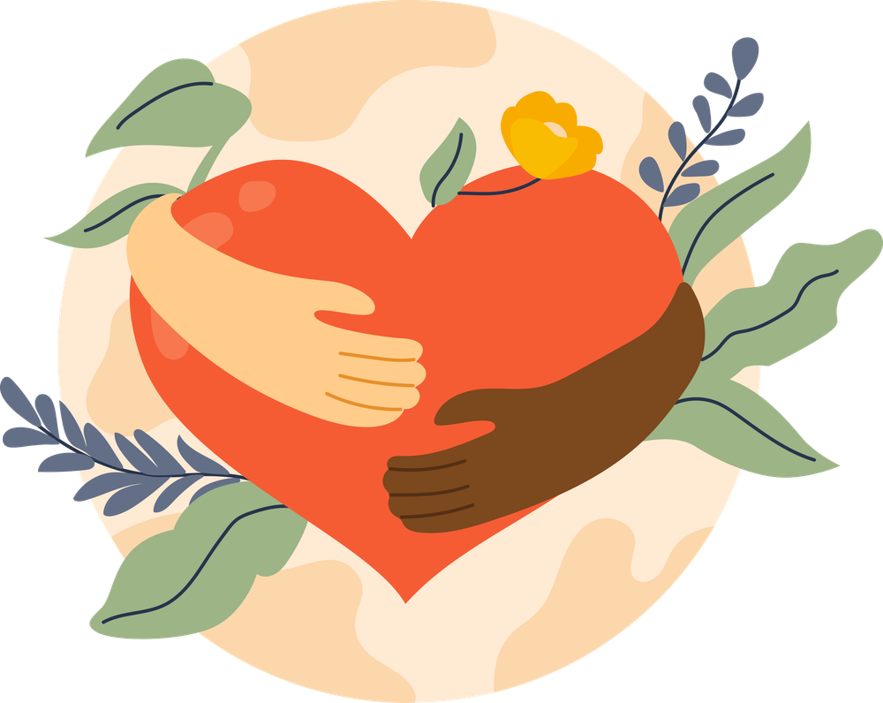
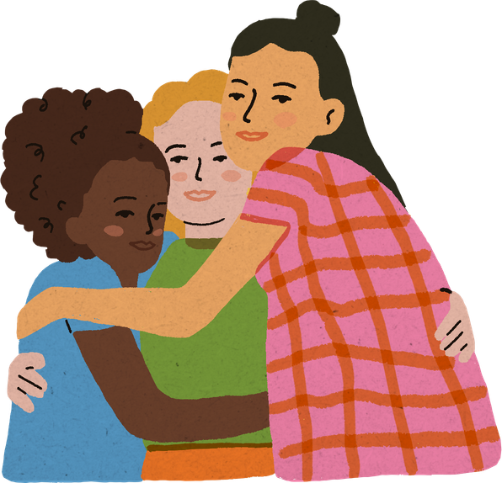
H
Connection helps us feel like we belong!
Just like pieces in a puzzle, every person is different, but when we connect with each other, we help the whole picture come together.
At school this could mean:
TRY IT!
  Feeling included – people invite you to play or work together
  Feeling safe – you know there are people who will help you
  Feeling cared about – others notice if you’re happy or sad
  Feeling confident – you know you’re not alone
  Feeling proud of your school community
Notes:
Ask everyone to:
Turn to the person next to them
Give them a smile
Say “I’m glad you’re here.”

Slide 9

CONNECT
THINK ABOUT WHAT CONNECITON MEANS AND HOW IT MAKES YOU FEEL
CONNECTION DETECTIVES
SPOT SOMEONE WHO MIGHT NEED A CONNECTION
SAY HELLO, ASK THEM TO PLAY OR SIT WITH THEM
THINK ABOUT HOW THAT FELT FOR YOU AND FOR THEM!
Notes:
Your job is to look around the playground and the classroom and spot someone who might need a connection.
That might be someone who:
Is standing by themselves
Looks a bit sad
Is new or unsure
Needs help with something
Then give the action:
When you spot them, do one simple thing:
Say hello, ask them to play, or sit with them.
If everyone here helps just one person feel included today, imagine how many people in our school will feel happier.

Slide 10
Small connections make a big difference !
CONNECT
Notes:
“Put your hand up if you have a friend.”
“Put your hand up if someone has ever helped you when you felt sad.”
“Put your hand up if someone smiling at you has made your day better.”

Slide 11



Thank You!

