Slide 1

5 WAYS TO WELLBEING
‘BE ACTIVE

Slide 2
MENTAL HEALTH AND WELLBEING
Wellbeing is...
  How we feel in our minds
  How we feel in our bodies
  How we get along with other people
  How we cope with our day
It’s about feeling safe, happy, healthy, and able to enjoy life, most of the time.
Everyone’s wellbeing goes up and down, and that’s completely normal.
Notes:
introduce wellbeing and why it is important
It helps us learn
It helps us make friends
It helps us solve problems
It helps us feel confident

Slide 3

KEEP LEARNING
BE ACTIVE
5 WAYS TO WELLBEING
TAKE NOTICE
CONNECT
GIVE
Notes:
Explain what mental health is – its about our feelings, thoughts, emotions and moods
Everyone knows how to look after their physical health – examples?
But it can be difficult to know what to do to look after our mental health.

Slide 4
We all need to move our bodies.
Being active is important because it helps your body stay strong and healthy, while also giving you more energy for the day.
BE ACTIVE
Notes:
“Put your hand up if you have a friend.”
“Put your hand up if someone has ever helped you when you felt sad.”
“Put your hand up if someone smiling at you has made your day better.”

Slide 5
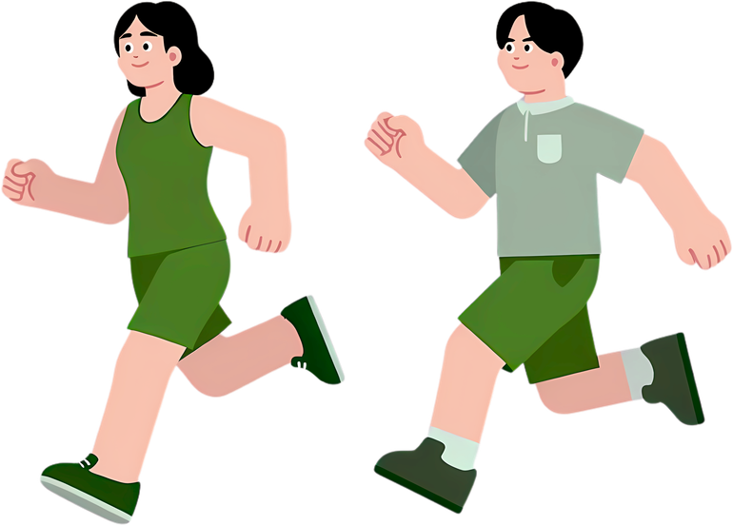
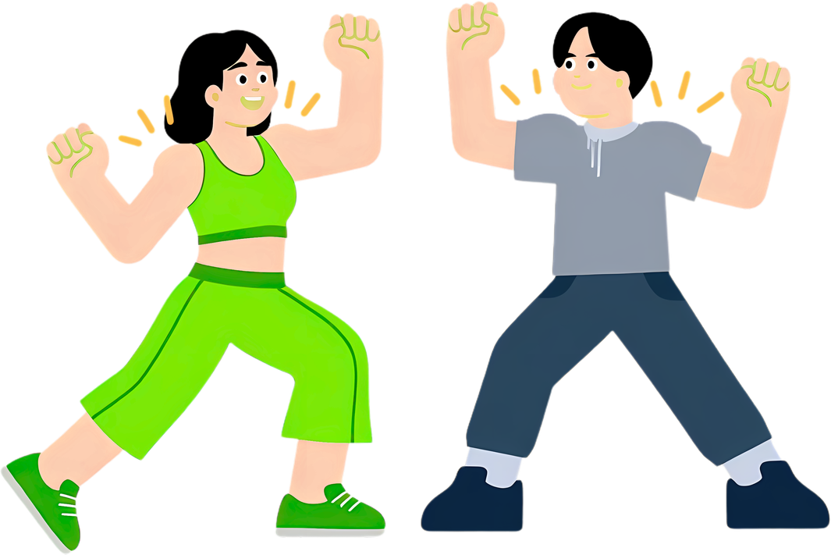
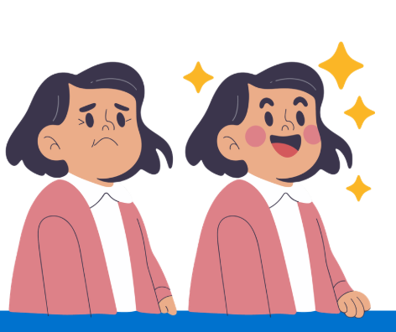
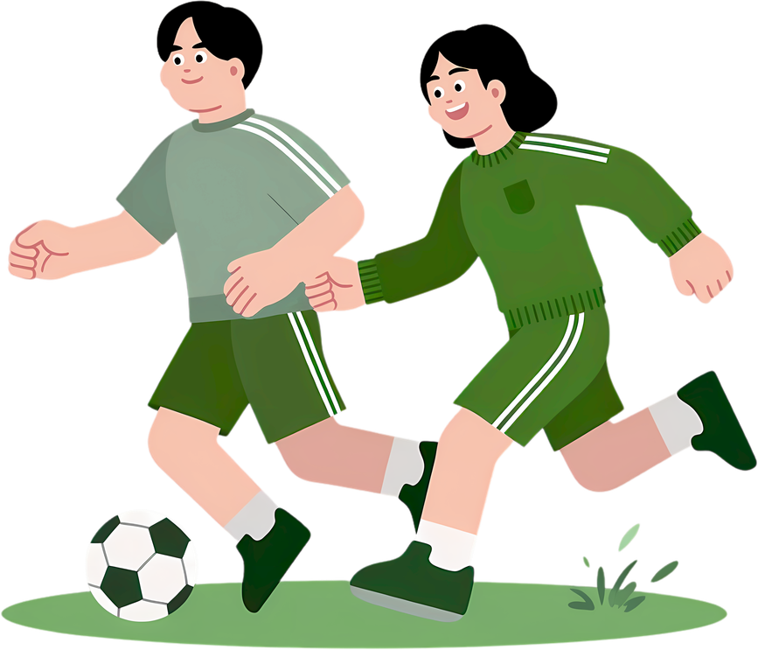
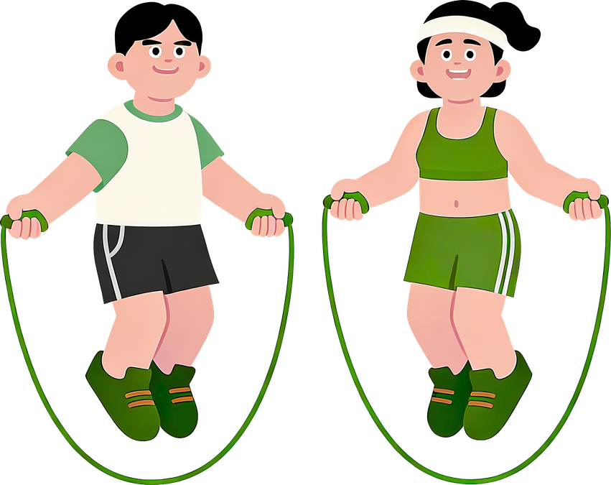
What do you like to do to be active?
H
Notes:
Active in many different ways
“If you feel angry → running or jumping can help you calm down.”
“If you feel sad → playing outside can help you feel a bit happier.”
“If you feel tired → moving can wake your brain up!”

Slide 6
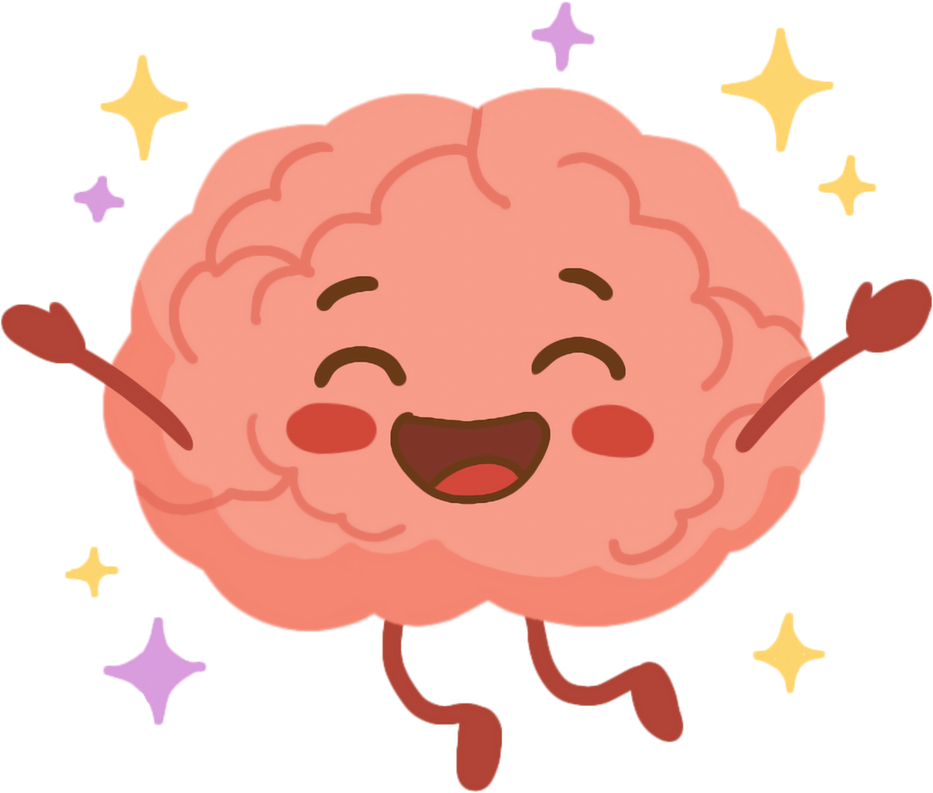
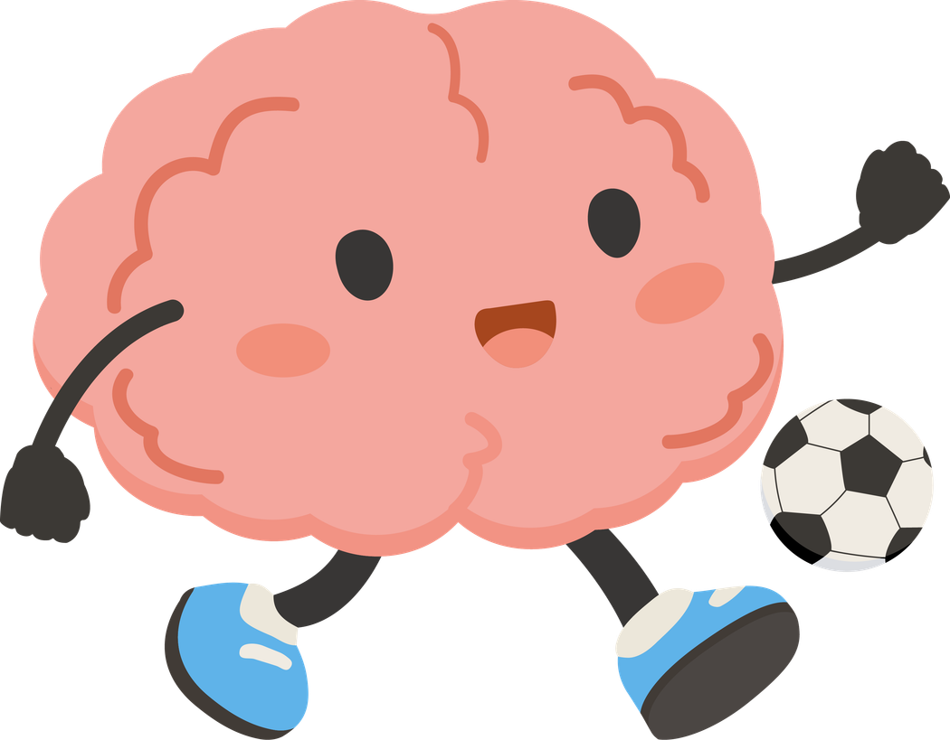
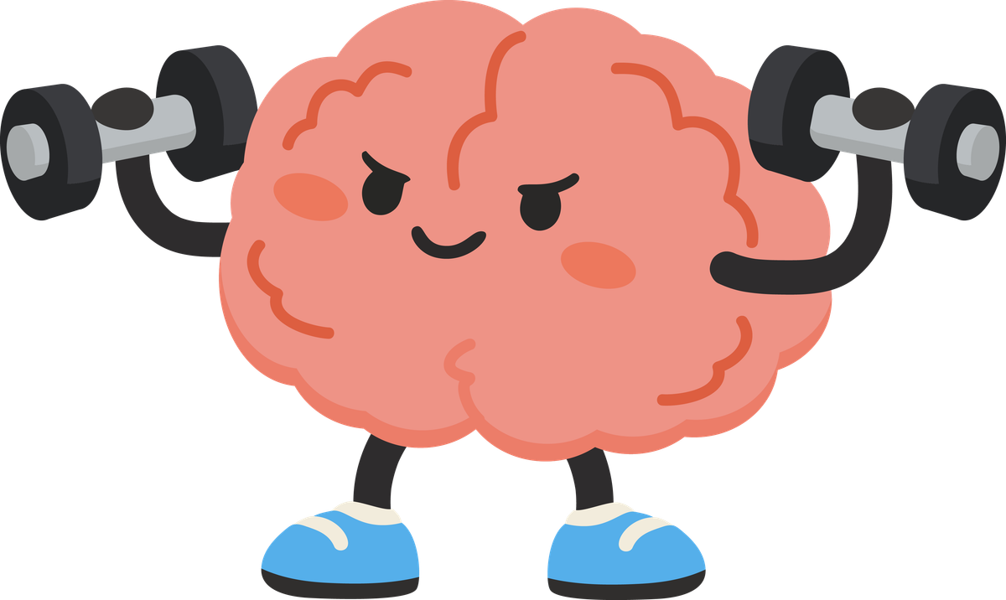
H
It can boost your mood by releasing feel-good chemicals in your brain and help you concentrate better in class.
Notes:
!
3.
Why did the cow go to space?
To see the moooon!
4.
Why did the student eat his homework?
Because the teacher said it was a piece of cake!
5.
Why was the maths book sad?
Because it had too many problems!
6.
Why did the pencil get an award?
Because it was very sharp!
7.
What do you call cheese that isn’t yours?
Nacho cheese!
8.
Why can’t you give Elsa a balloon?
Because she will let it go!
Turn to the person next to you and smile..

Slide 7
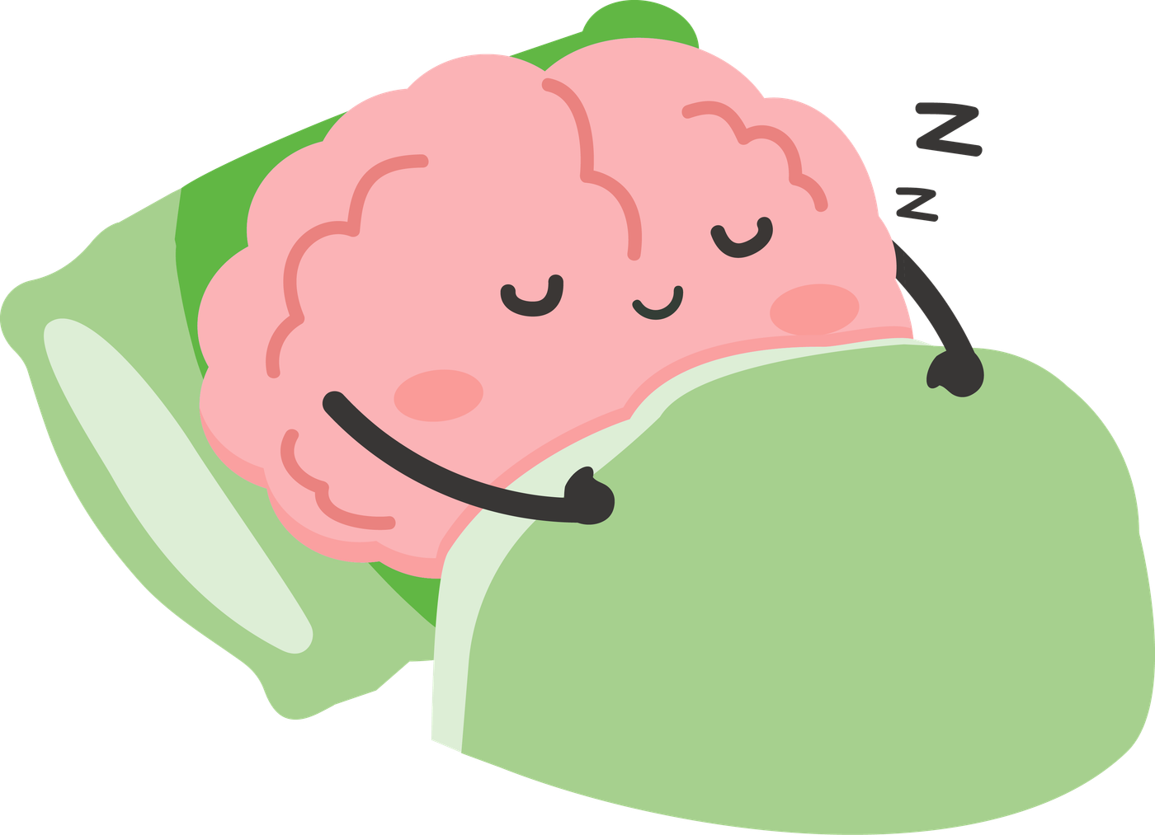
H
Being active also helps you sleep well and have fun with friends.
Notes:
How can someone help you with big or difficult emotions?

Slide 8
How are you feeling right now?
H
Notes:
Ask everyone to:
Turn to the person next to them
Give them a smile
Say “I’m glad you’re here.”

Slide 9
BE ACTIVE
A LITTLE MOVEMENT EVERY DAY CAN MAKE A BIG DIFFERENCE
SHOW SOMEONE A NEW DANCE MOVE
TRY AND MOVE IN SLOW MOTION AT LUNCH
TRY MOVING FOR 5 MINS TO CHANGE HOW YOU FEEL
MOVE YOUR BODY FOR A WHOLE 10 MINUTES
Notes:
Your job is to look around the playground and the classroom and spot someone who might need a connection.
That might be someone who:
Is standing by themselves
Looks a bit sad
Is new or unsure
Needs help with something
Then give the action:
When you spot them, do one simple thing:
Say hello, ask them to play, or sit with them.
If everyone here helps just one person feel included today, imagine how many people in our school will feel happier.

Slide 10
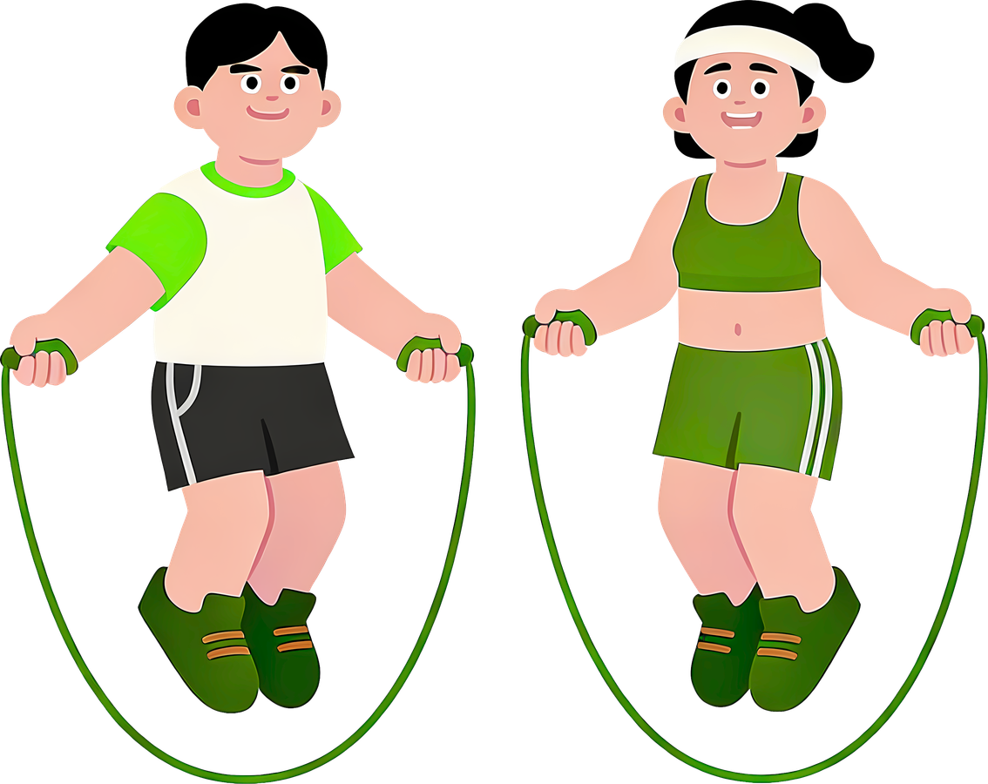
BE ACTIVE
Move my body, boost my mood!
Notes:
“Put your hand up if you have a friend.”
“Put your hand up if someone has ever helped you when you felt sad.”
“Put your hand up if someone smiling at you has made your day better.”

Slide 11


Thank You!

