Slide 1

Oak Class
Meet the teacher
Year 5 and 6
Denham Village School

Slide 2


Slide 3
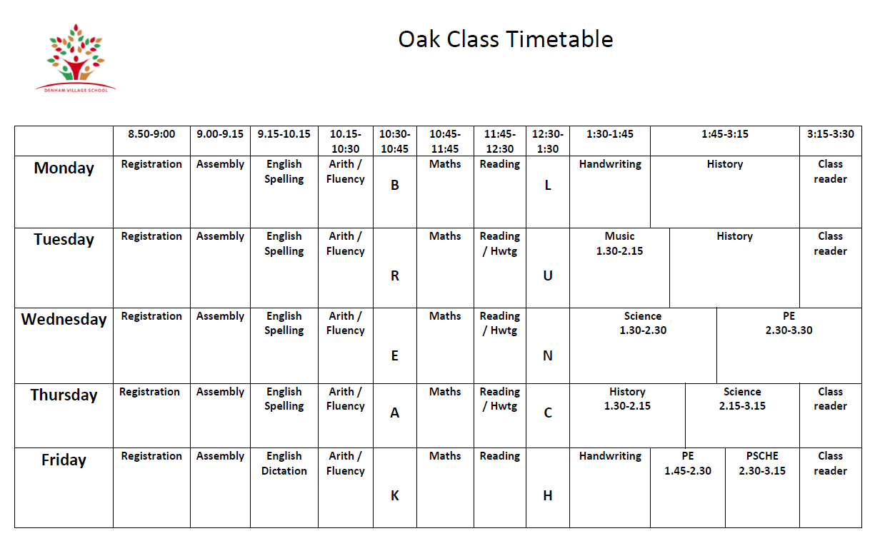

Slide 4
Our Topics
Autumn 1
What was life like in Tudor England?
Autumn 2
Why does population change?
Spring 1
What did the Greeks ever do for us?
Spring 2
Why do oceans matter?
Summer 1
Unheard histories: Who should feature on the £10.00 banknote?
Summer 2
Can I carry out an independent fieldwork study?

Slide 5


Trips

Slide 6
How is Upper Key Stage 2 different?
Notes:
Developing independence, responsibility, role models, academically (higher expectations) consistency

Slide 7
Supporting your child
Reading daily (at least 5 times a week)
Modelling Reading
Discussing what they have been reading
Ask your child to summarise
Vocabulary
Read to your child.

Slide 8
Homework
Daily reading
Daily arithmetic
Sumdog activities
Notes:
Additional online activities may be sent during this year.

Slide 9



Behaviour

Slide 10
PE
Wednesday and Friday

Slide 11
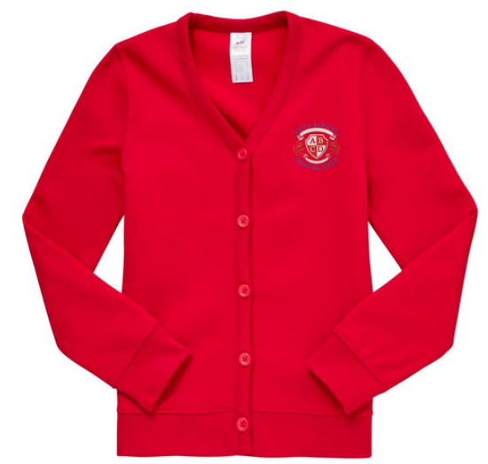



School Uniform
Please check the link on the school website.
PE kits

Slide 12

What should my child bring to school?
Pens, pencils, colouring pencils, 15cm ruler, eraser, pencil case, whiteboard pen.
Reading book and planner every day
School bags and coats will be hung on the child’s peg. Please ensure everything is named.
Lunchboxes are stored in the hall.
Children can bring in a healthy snack for playtimes e.g. fruit. If using a container for the snack, please ensure your child’s name is written on it.

Slide 13
Water Bottles
Children must also bring a water bottle to school everyday. They are stored near the sink. They can drink water in the classroom at appropriate times and take them outside at playtimes.

Slide 14
Please ensure your child is on the playground ready to enter the classroom at 8:50am. The school day finishes at 3.30pm.
•If your child comes to breakfast club, this starts from 8am onwards.
•If someone other than you is picking up your child please let the office and me know in advance.
•If you are picking up your child during the school day, e.g for a medical appointment, please ensure that you let the office know and they will pass the message on to me.
Drop offs and pickups

Slide 15
Attendance
Notes:
Talk about the importance of attendance

Slide 16
Communication
Please call the office or speak to me after school.
Messages can also be written in the diary.

Slide 17
Responsibilities
House Captains
Sports Captains
Star of the week
Vital classroom responsibilities and around the school.

Slide 18

Deadline: 31st October

Slide 19
Reminders
Daily reading
Planners and reading books in school every day
Arithmetic homework to be returned by Monday
Wednesday and Friday – wear fleeces and PE kit
Bring water bottle, pencil cases and stationery essentials every day.

Slide 20
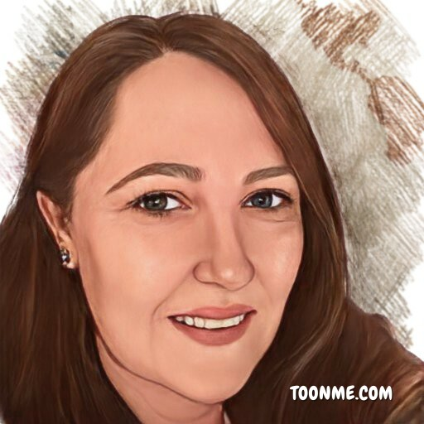
Thank you for your time. Any questions?

