Slide 1


Willow Class
Meet the teacher
Year 3 and 4
Denham Village School

Slide 2


Slide 3







Let’s work together as a team to give our children the best possible chance of reaching their full potential and achieving success
KS1 - LKS2 - UKS2

Slide 4

Meet the team
Miss Clark– Class Teacher
Mrs Huzaifa – HTLA
Mrs Masters, Mrs Burge &
Miss Godbolt – Learning Support Assistants

Slide 5


Slide 6
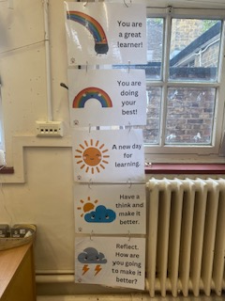



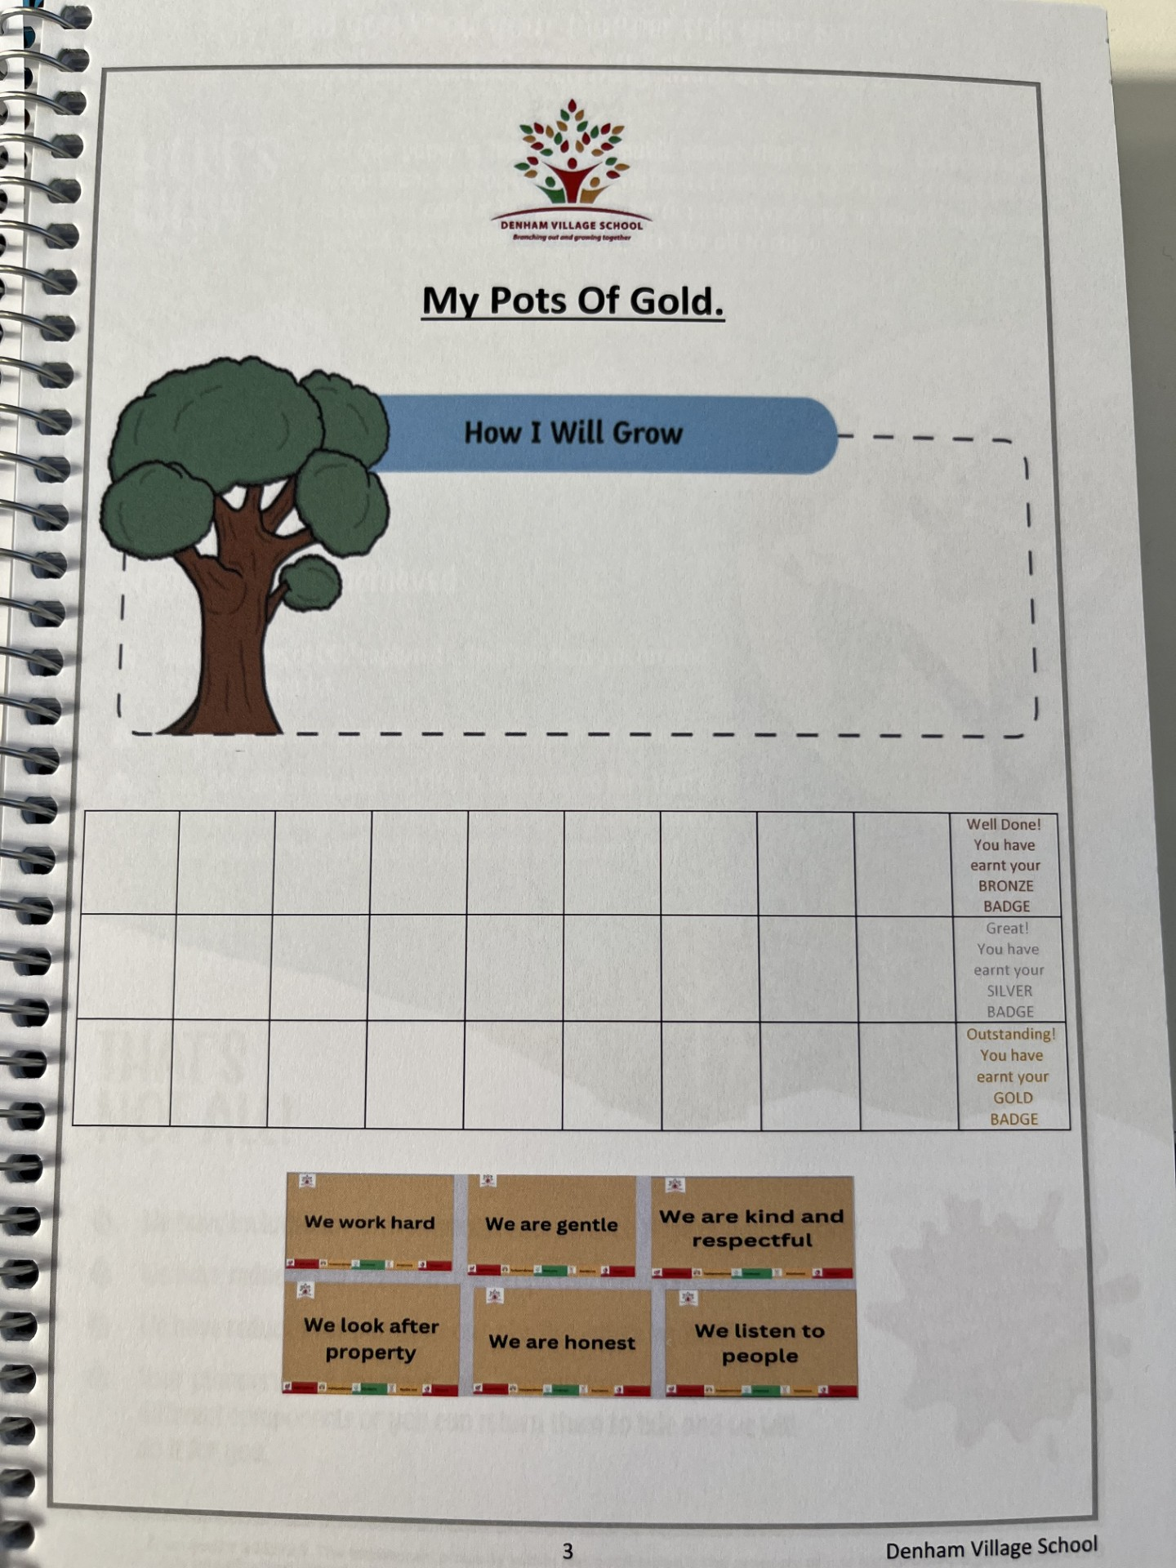
Behaviour Charts

Slide 7
Transitioning from KS1 to KS2. What’s different?
Greater Independence with tasks
Organisation skills
Transitioning away from phonics, moving towards spelling patterns
4. Year 4 Multiplication Check –Sum Dog
Notes:
Appreciate half of the class remaining in KS2.
1. Greater child independence
As teachers, we want to see the children we teach grow in independence. In KS1, children will need a lot more support to complete tasks. However, we hope that by the end of KS2, children will be able to take ownership of their learning, find the resources they need within the classroom and build strategies for success themselves.
By KS2, most children will be able to read and write with greater independence. More deeply, however, they will be able to take ownership of their learning more and more. They will be able to recognise where they need help and how to get the support they need.
2. Social skills and friendships
As children get older, their social skills develop. They will become more aware of themselves and others. In KS2 is when children start to build further friendships, I think it’s really nice for this class as they are familiar with each other from their time in Birch class. As children get older, it’s important for them to learn skills to resolve any issues that may arise and learning how to deal with more complex relationships with friends.
Year 4 – while not statutory, we feel it knowing times table is really important for children to know as it builds the foundation of Maths. So will be tested.

Slide 8
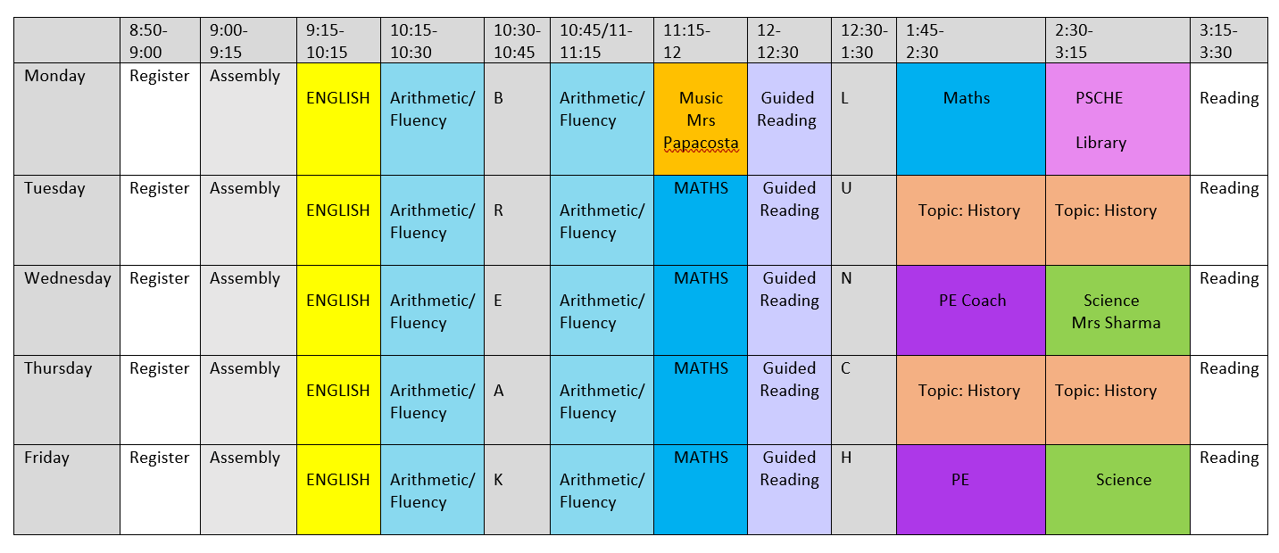
Changes this year
Blocking for topics
Maths Homework- Daily ‘Tough Ten’ & Sum Dog Tasks
Discrete Spelling lessons focusing on teaching and learning, and application in writing. Dictation will replace weekly testing of word lists

Slide 9

Changes to spelling:
Shift in approach from weekly word tests to pattern-based spelling instruction
Goal: apply learning to unfamiliar words and everyday writing
✓ Teaching focuses on patterns, rules and word structure.
✓ Learning is embedded in writing and revisited frequently.
✓ Assessment is broader than a weekly test.
✓ The aim is transferable spelling knowledge for life-long writing.

Slide 10
Our Topics for this academic year:
 | Autumn 1 | Autumn 2 | Spring 1 | Spring 2 | Summer 1 | Summer 2
History/ Geography Topics | What was so important to ancient Egyptians? | Why are rainforests important to us? | What changed in Britain after the Anglo Saxon Invasion? | Why do people live near volcanoes? | Were the Vikings raiders, traders or settlers? | What are rivers and how are they used?

Slide 11

What should my child bring to school?
Pens, pencils, colouring pencils, 15cm ruler, eraser, pencil case, whiteboard pen.
Reading book and planner every day
School bags and coats will be hung on the child’s peg. Please ensure everything is named.
Lunchboxes are stored in the hall.
Break Time fruit is available daily. Children may bring in their own healthy snack for playtimes. If using a container for the snack, please ensure your child’s name is written on it.

Slide 12

Water Bottles
Children should bring a water bottle to school everyday. They are stored near the sink. They can drink water in the classroom and take bottles outside at playtimes.

Slide 13



School Uniform
Please check the link on the school website
Children come to school wearing PE kits on our PE days: Wednesday and Friday
Please ensure uniforms have name labels

Slide 14
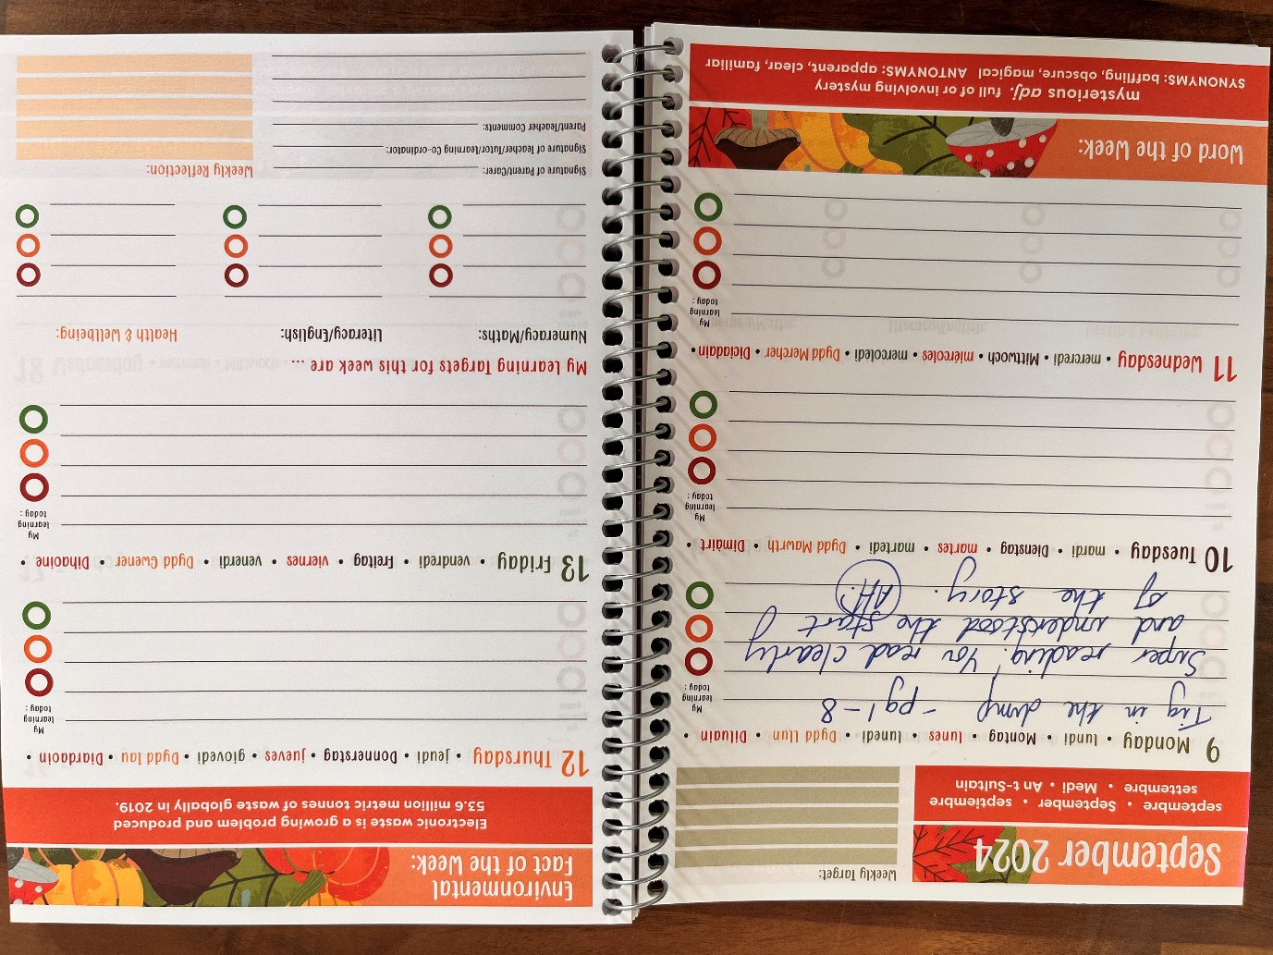
Homework
Daily reading
Daily arithmetic
Sumdog activities
Home Thursday → Back in on Tuesday
Spellings will be taught, practised and then applied and assessed through dictation
Please see school website for curriculum information
Notes:
Additional online activities may be sent during this year.

Slide 15
Key notes:
PE Wednesdays and Friday. Autumn PE topics are Netball (PE Coach) and Dance (Miss Clark)
Music – Mrs Papacosta
Science – Mrs Sharma & Miss Clark
Forest school will be in the Spring term
Notes:
Personal, Social, Health and Citizenship Economic Education

Slide 16

Please ensure your child is on the playground ready to enter the classroom at 8:50am. The school day finishes at 3.30pm.
•If your child comes to breakfast club, this starts from 8am onwards.
•If you are picking up your child during the school day, e.g for a medical appointment, please ensure that you let the office know and they will pass the message on.
Drop offs and pickups

Slide 17
Supporting your child
Reading daily (at least 5 times a week)
Modelling Reading
Discussing what your child has been reading
Ask your child to summarise
Discuss new Vocabulary and meanings
Read to your child as well as listening to them read

Slide 18

Reading at home
What if my child struggles with a book?
Allow time for your child to self-correct
Re-read pages to develop fluency, expression and
comprehension
My child finds their book easy. What should I do to challenge them?
Discuss the pictures, characters and plot
Focus on asking questions to allow the children to think beyond the story, linking to their own experiences
Remember children should be reading the book at 90% fluency
Encourage expression for characters

Slide 19
Reminders
Daily reading
Planners and reading books in school every day
Arithmetic homework to be returned by Tuesday
Wednesday and Friday – wear fleeces and PE kit
Bring water bottle, pencil cases and stationery essentials every day
Sumdog logins are in the front of planners

Slide 20


